Slide 1
NETWORK TROUBLESHOOTING

Slide 2
Table of Content
Hardware based issues in a network
General tips to troubleshoot hardware issues
Cable Problems
Connectivity problems
Excessive Network Collisions
Software based issues in a network
Ping tests
Trace route testing
Using NSlookup to troubleshoot DNS problems
Network Error Codes
500: Internal Server Error
502 Bad Gateway
403 Forbidden
Necessity of a system documentation

Slide 3
Hardware based issues in a network
Hardware troubleshooting is the process of reviewing, diagnosing and identifying operational or technical problems within a hardware device or equipment.
It aims to resolve physical and/or logical problems and issues within a computing hardware.
This type of problem usually results in delays, timeouts or simply just no response in a network.

Slide 4
General tips to troubleshoot hardware issues
Removing, repairing and replacing faulty RAM, hard disc or video/graphic card.
Cleaning dusts from RAM and Video carts slot/ports and from cooling fan.
Tightening cable and jumpers on motherboard and/or components.
Software related hardware problems like driver update or installation.

Slide 5
Cable Problems
Cables that connect different parts of a network are often cut or severely damaged.
A short circuiting can happen when the wire conductor comes in touch with another conductive surface, changing the trail of the signal.
Cable testers are often wont to test for several sorts of cable problems such as: Cut cable, incorrect cable connections, Cable shorts, Interference level, Connector Problems
This is usually the foremost common problem but is sort of the task to get during a large network.

Slide 6
Connectivity problems
A connectivity problem with one or more devices during a network can occur after a change is formed in configuration or by a malfunction of a connectivity component, like hub, a router or a Switch.
As such there are devices like routers and switches are often placed in rack mounts with patch panels set plugged in with keystones in order that during maintenance of the devices the device itself doesn’t get harmed.

Slide 7
Excessive Network Collisions
These often cause slow connectivity.
The problem can occur as a results of bad network setup/plan, a user transferring tons of data or jabbering network card.
A jabbering Network card may be a network card that's stuck during a transmit mode.
This will be evident because the transmit light will remain on constantly, indicating that the Network card is usually transmitting.

Slide 8
Software based issues in a network
There are multiple ways to repair software issues and identify them, just because there are numerous software issues during a network.
Usually if after troubleshooting all the hardware problems that would possibly exist, then it's advised to maneuver towards using troubleshooting methods to spot software problems.

Slide 9
Ping tests
The most commonly used network tool is that the ping utility. This utility is employed to supply a basic connectivity test between the requesting host and a destination host.
This is done by using the web Control Message Protocol (ICMP) which has the power to send an echo packet to a destination host and a mechanism to concentrate for a response from this host.
This utility is usually wont to provide a basic picture of where a selected networking problem may exist.

Slide 10
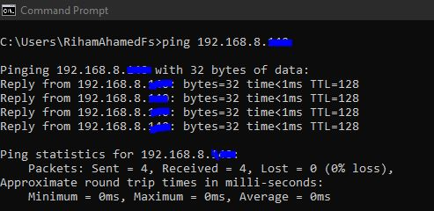

Slide 11
Trace route testing
Typically, once the ping utility has been wont to determine basic connectivity.
The tracert / traceroute utility can wont to determine more specific information about the trail to the destination host including the route the packet takes and therefore the reaction time of those intermediate hosts.
The tracert utility and traceroute utilities perform an equivalent function but operate different operating systems, Tracert for Windows machines and traceroute for GNU/Linux based machines.

Slide 12
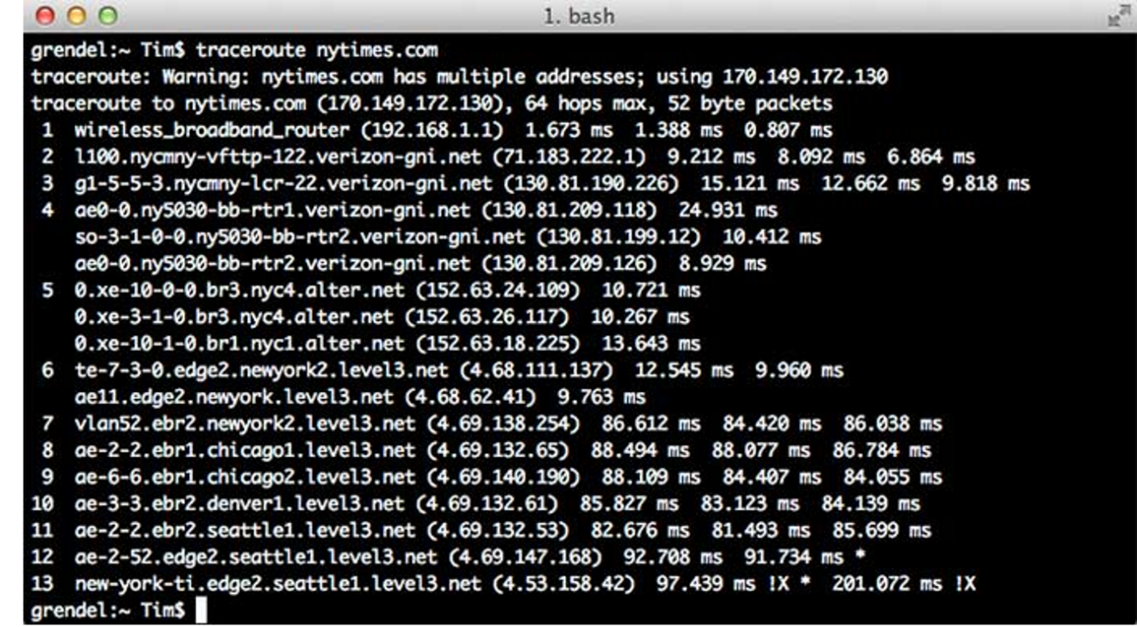

Slide 13
Using NSlookup to troubleshoot DNS problems
Some of the foremost common networking issues revolve around issues with Dynamic Name System (DNS) address resolution issues.
When this technique doesn't work, most of the functionality that folks are wont to goes away, as there's no thanks to resolve this information.
The nslookup utility are often wont to lookup the precise IP address related to a website name. If this utility is unable to resolve this information, there's a DNS issue.

Slide 14
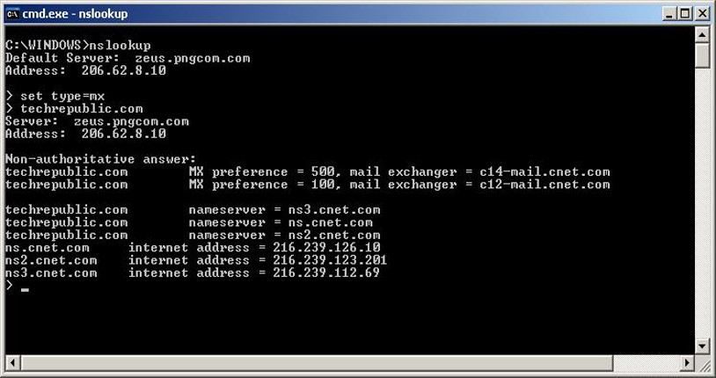

Slide 15
Network Error Codes
Commonly, error codes occur when the network is usually connected to the web .
Each particular set of error codes have their own implication on what the matter is, this might give us insight on what we should always do to repair the matter . The upcoming slides will explain a number of the common error codes.
Below may be a general description of errors during a network;
1xx: Informational
2xx: Success
3xx: Redirection
4xx: Client Error
5xx: Server Error

Slide 16
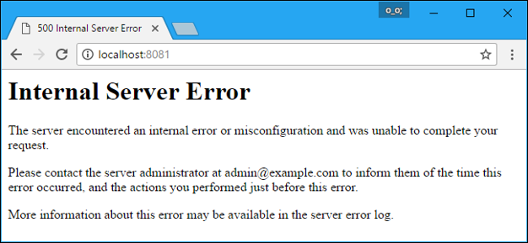
500: Internal Server Error
Internal Server Error, means server cannot process the request for an unknown reason.
Sometimes this code will appear when more specific 5xx errors are more appropriate.
This commonest cause for this error is server misconfiguration or missing packages

Slide 17
502 Bad Gateway
This means that the server may be a gateway or proxy server, and it's not receiving a legitimate response from the backend servers that ought to actually fulfill the request.
If the server in question may be a reverse proxy server, like a load balancer, here are a couple of things to check:
The backend servers (where the HTTP requests are being forwarded to) are healthy
The reverse proxy is configured properly, with the right back endes specified
The network onnection between the backend servers and reverse proxy server is healthy. If the servers can communicate on other ports, confirm that the firewall is allowing the traffic between them
If your web application is configured to concentrate on a socket, make sure that the socket exists within the correc location which it's the right permissions

Slide 18
403 Forbidden
A Forbidden error, means the user made a legitimate request but the server is refusing to serve the request, thanks to a scarcity of permission to access the requested resource.
403 errors commonly ocur when the user that's running the online server process doesn't have sufficient permissions to read the file that's being accessed.

Slide 19
Necessity of a system documentation
You can’t secure your network without having any idea how it’s connected.
In the event of an accident or some issue, you'll just refer the system documentation for guidelines.
The same network administrator won’t work forever in your company.
Troubleshooting from scratch isn’t easy without having any idea about the network.
Network devices don't last forever, they need to get replaced .

